Slide 1
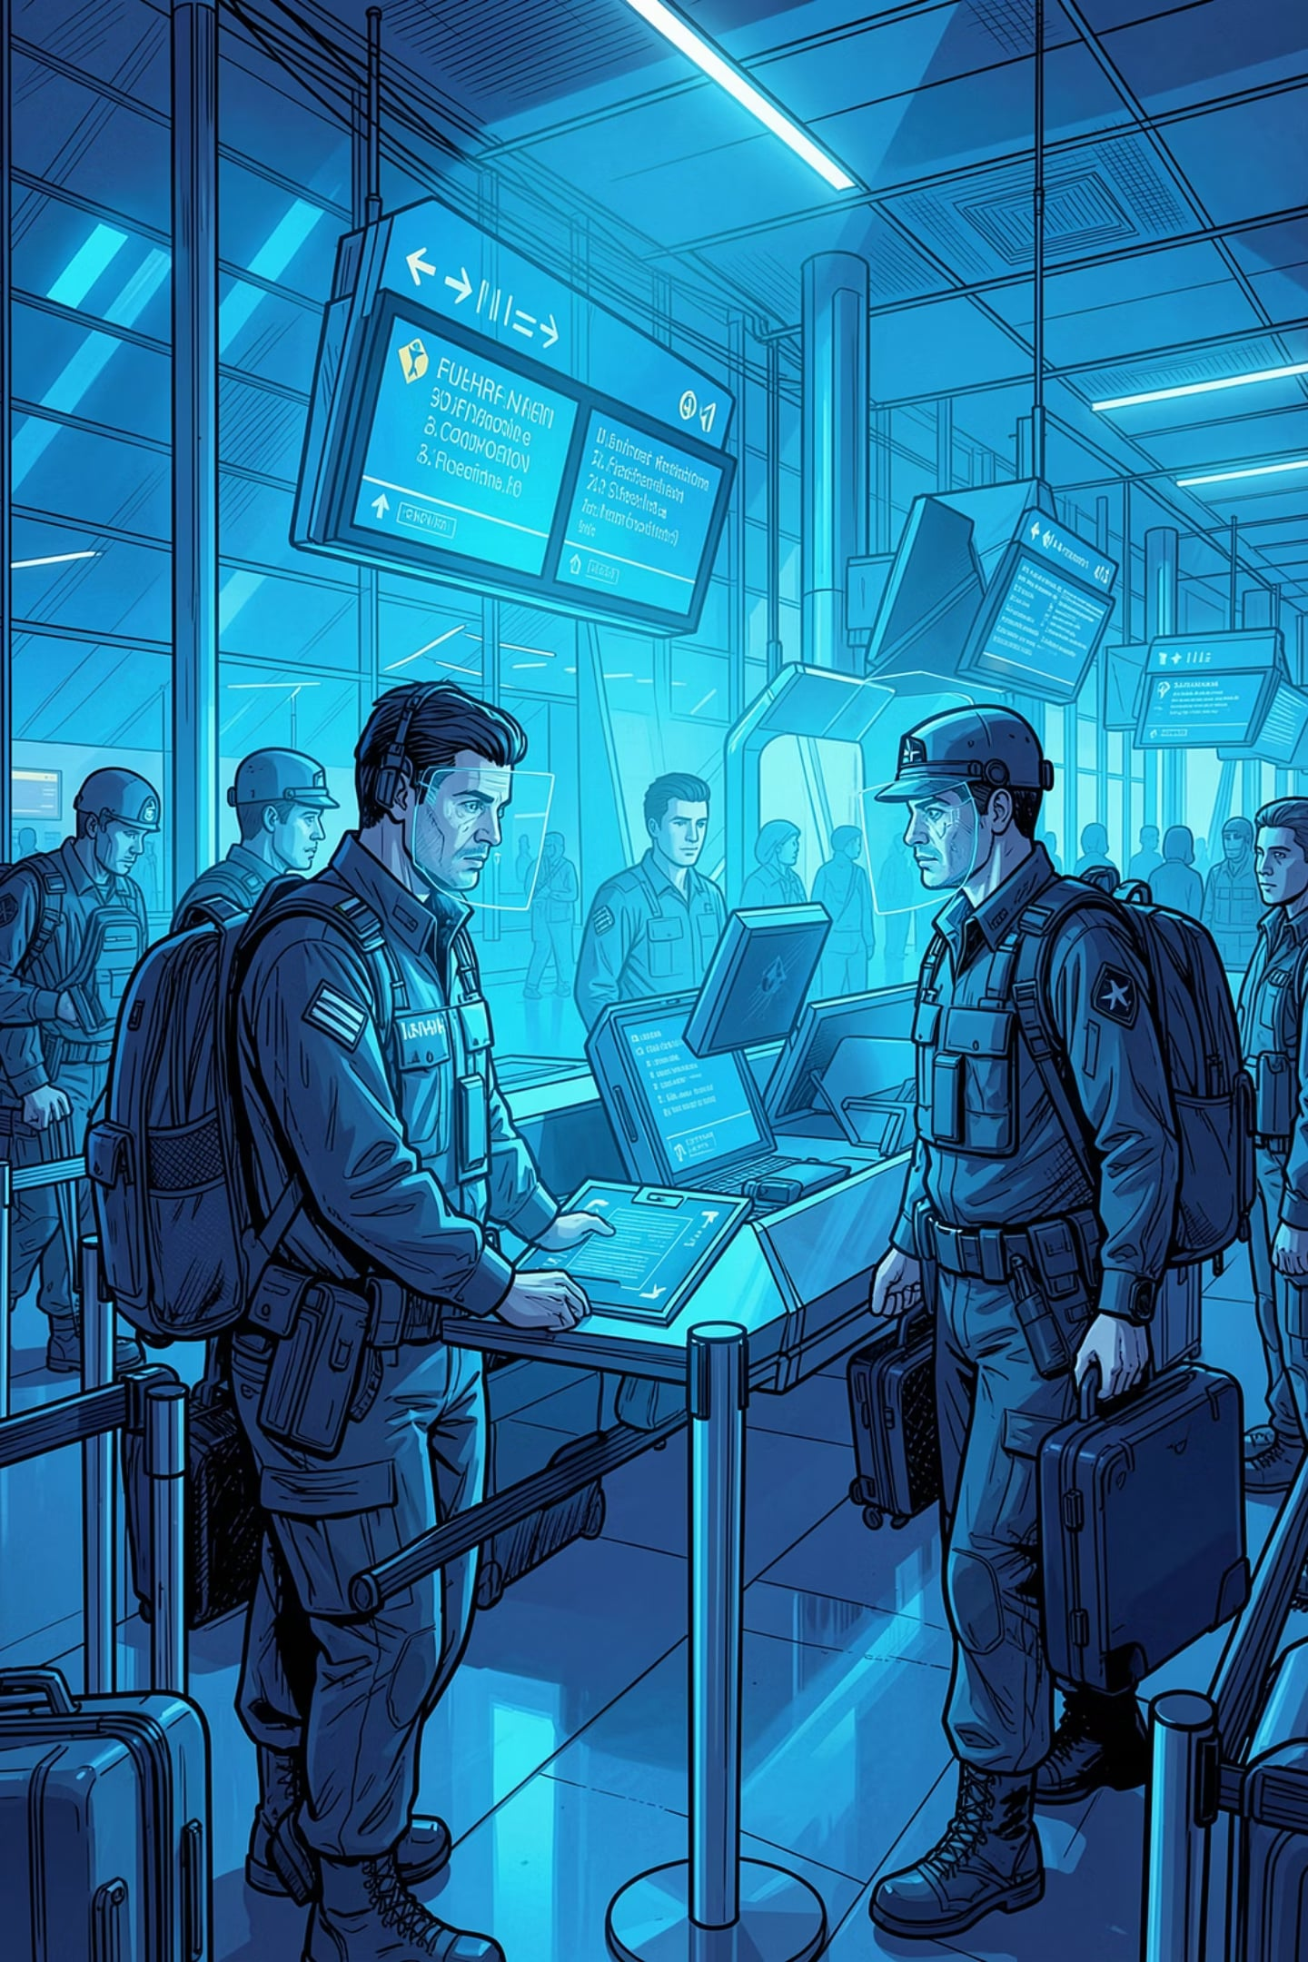
Securing the Skies: AI Face Recognition in Modern Airports
CH.V.Rama Yogi
192424319
DSA-0202
Computer Vision With Open CV
Dr.M.Mayuranathan
Professor
SIMATS Engineering

Slide 2

INTRODUCTION
1
AI face recognition is widely used in modern airports to improve security and passenger safety.
It captures a passenger's face and verifies their identity quickly without manual checks.
2
3
Image processing enhances the captured image by removing noise and improving quality.
Computer vision analyzes and recognizes faces accurately. Camera models ensure clear image capture for reliable identification.
4

Slide 3
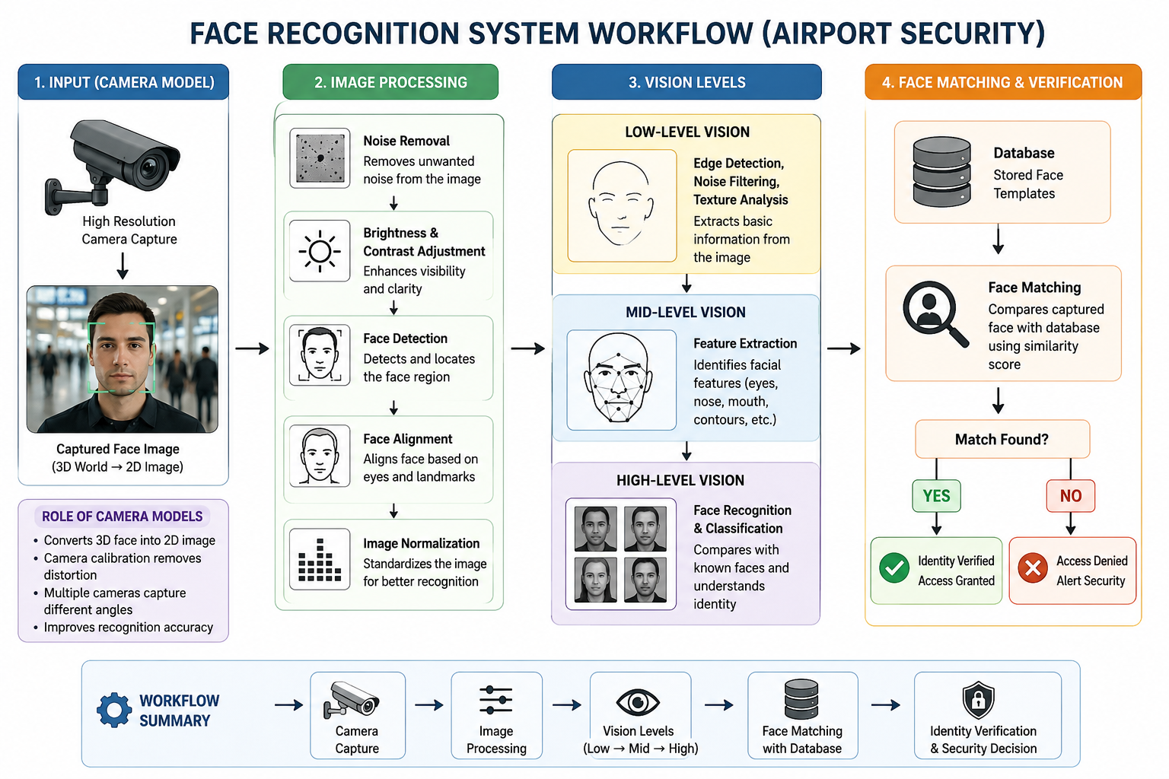

Slide 4
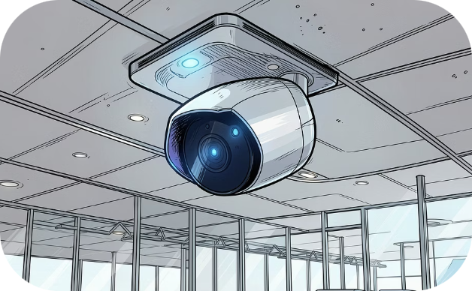
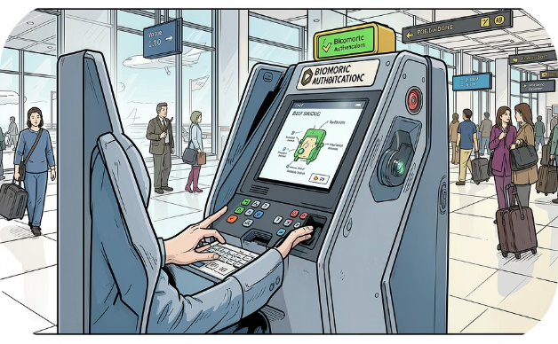
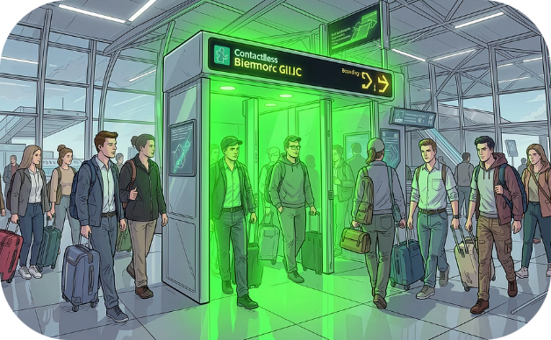
Camera Models & Future Integration
Edge AI Cameras
Integrated Hardware
Operational Impact
Processing data locally to reduce latency and enhance privacy — ideal for instant security alerts without cloud dependency.
Embedded cameras in kiosks and mobile devices enable frictionless passenger enrollment and seamless authentication.
Replacing manual ID checks with contactless, scalable biometric systems to create a truly smart, high-efficiency travel hub.

Slide 5
CONCLUSION
Image processing improves face image quality for accurate recognition.
Vision levels extract and identify facial features step by step.
Camera models ensure clear and distortion-free face capture.
Together, they enable fast, reliable, and secure airport face recognition.

Slide 6
THANKYOU

